Slide 1
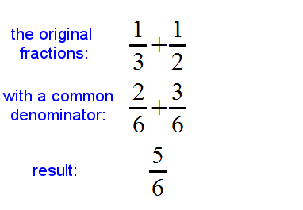
Add and subtract fractions with like denominators
With like denominators, you're basically just adding or subtracting the numerators.
Simplify if necessary

Slide 2
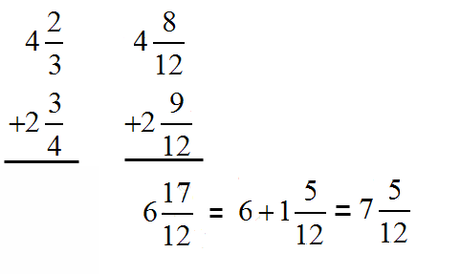
Before you can add or subtract fractions with different denominators, you must first find equivalent fractions with the same denominator, like this:
Find the smallest multiple (LCM) of both numbers.
Rewrite the fractions as equivalent fractions with the LCM as the denominator.

Slide 3
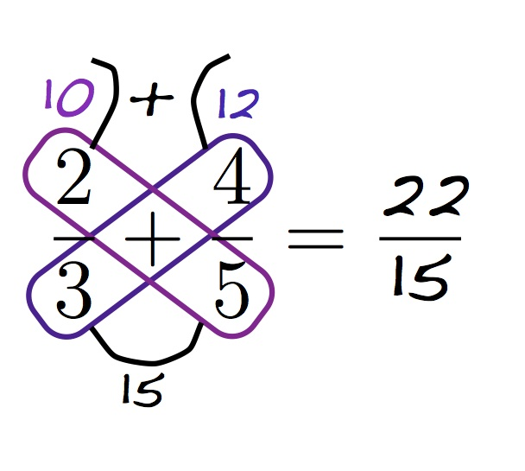
Adding and Subtracting Fractions Butterfly Method
https://www.youtube.com/watch?v=NDUid0x7AK4

Slide 4



Multiply Fractions
Example 1
Example 2
To multiply fractions:
Simplify the fractions if not in lowest terms.
Multiply the numerators of the fractions to get the new numerator.
Multiply the denominators of the fractions to get the new denominator.
Simplify the resulting fraction if possible.
Click on the example.
Example 2
https://www.youtube.com/watch?v=B7MtFQW7i_I

Slide 5

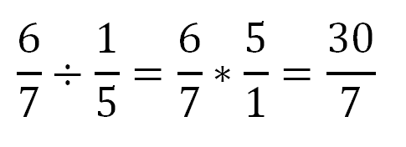
Divide Fraction
To divide any number by a fraction:
First step: Find the reciprocal of the fraction.
Second step: Multiply the number by the reciprocal of the fraction.
Third step: Simplify the resulting fraction if possible.
Fourth step: Check your answer: Multiply the result you got by the divisor and be sure it equals the original dividend.
Example 1
Example 2

